Slide 1
Conquering Difficult Conversations
"Hanging Out at Potato Chip Rock – Mt." (CC BY-NC-ND 2.0) by Sam Antonio Photography
Drupalcamp Atlanta 2018

Slide 2
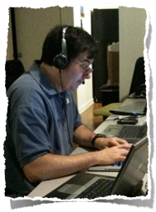
Johnnie Fox
husband • father•geek • woodworker• vintage receiver restorer • motorcyclist • caregiver • kayaker • traveler •
Developer
Technical Project Manager
CTO
VP Operations - www.prometsource.com
10 years small and large projects
Notes:
why - Prometsource grew from 10 to 45 people - need to pass this information on

Slide 3
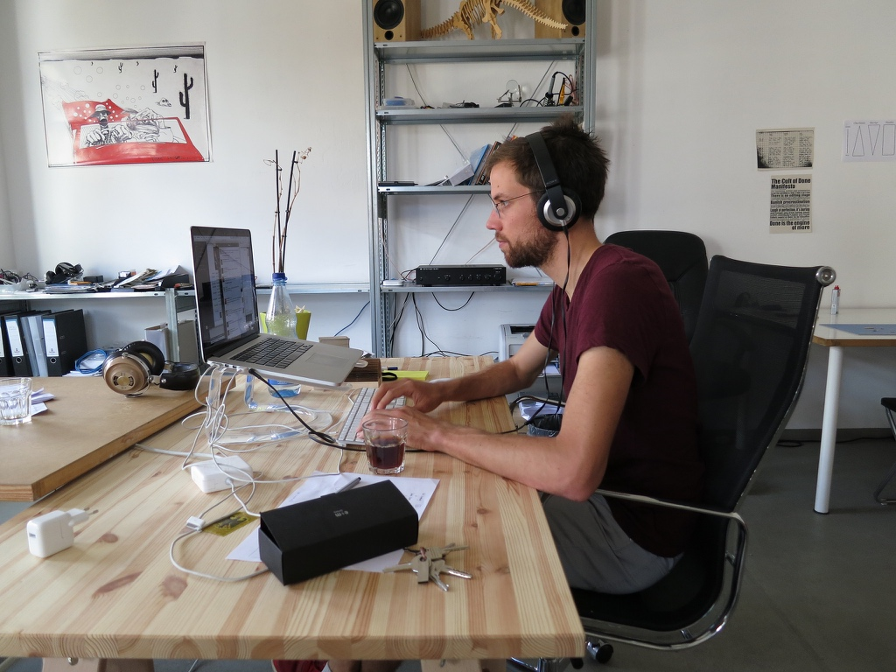
Developer

Slide 4
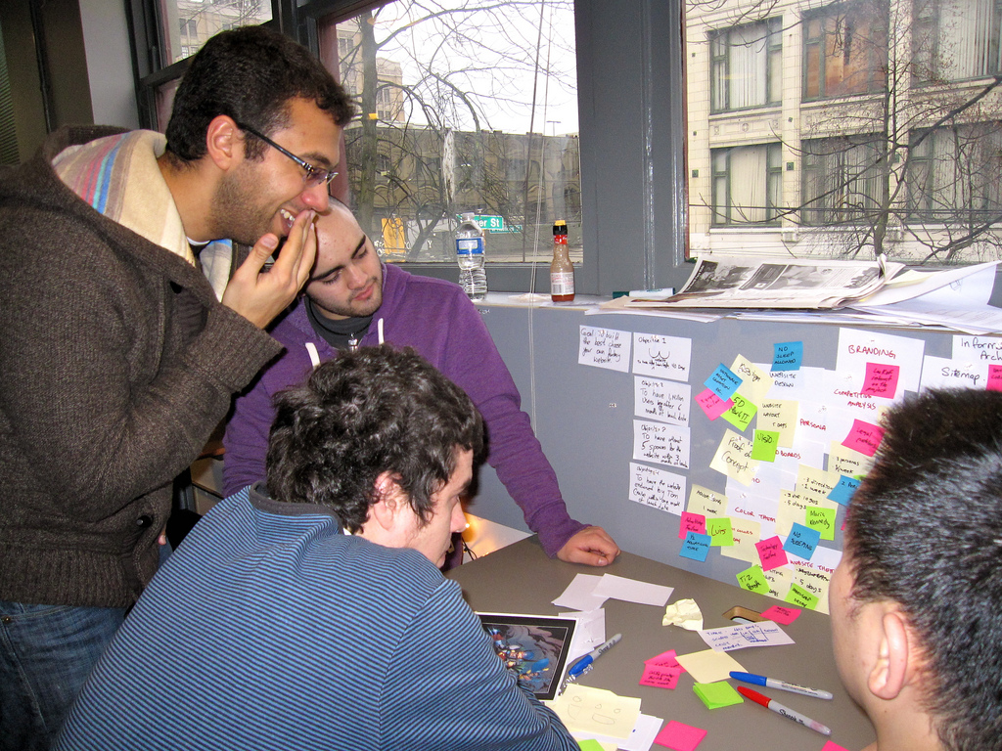
Project Manager
"Agile Project Management" (CC BY 2.0) by VFS Digital Design

Slide 5
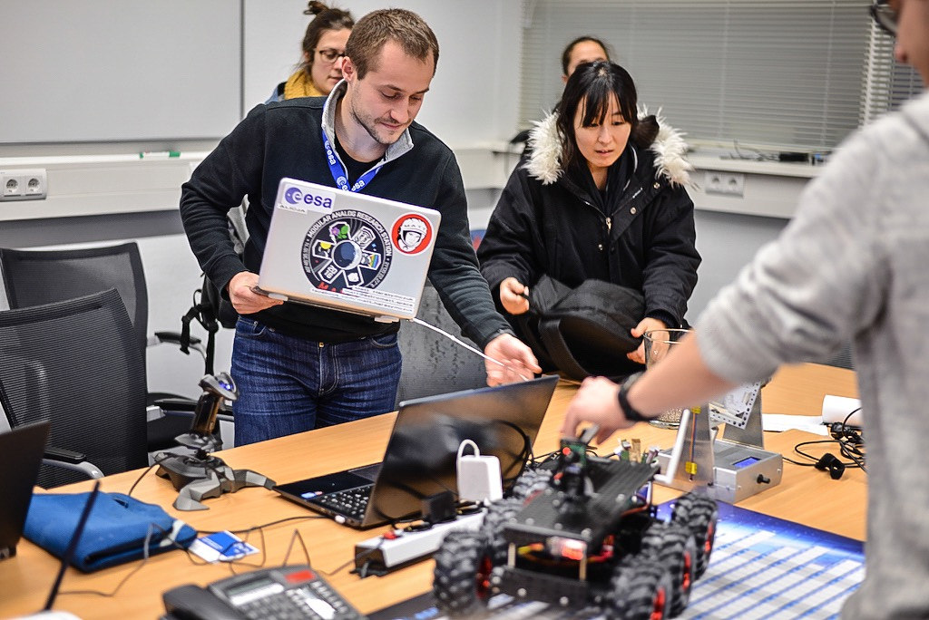
CTO
"Engineering" (CC BY-SA 2.0) by astro_matt

Slide 6
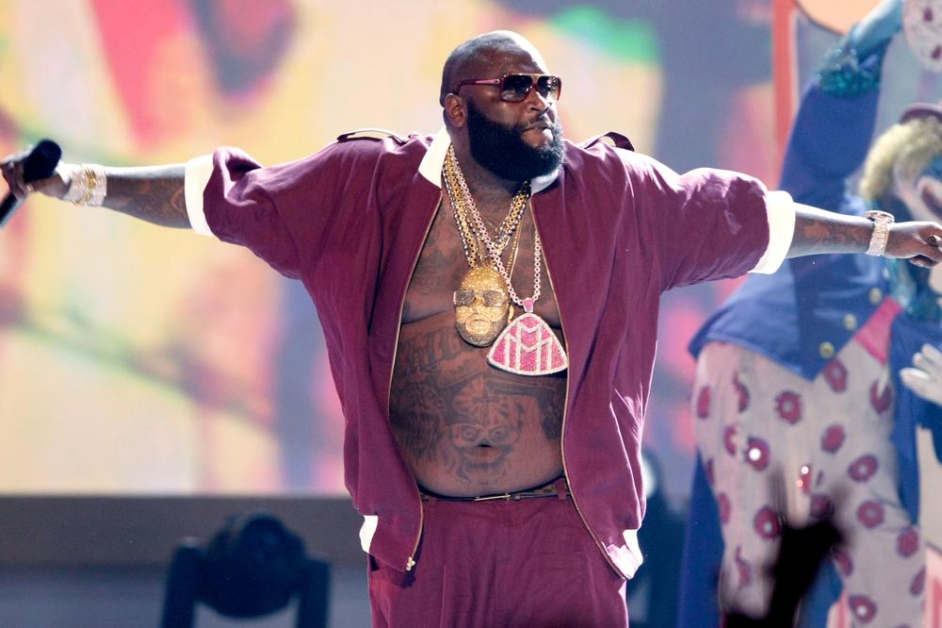
VP of Operations
Notes:
Top of the food chain?
No more day to day conflicts?
WRONG

Slide 7
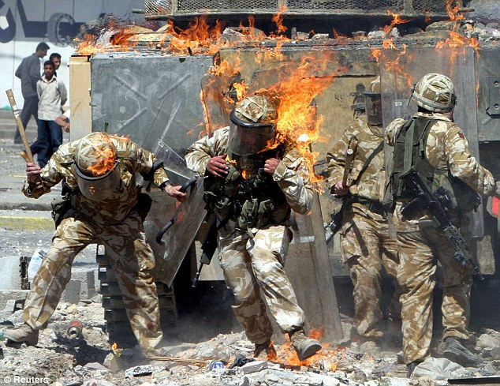
VP of Operations
Notes:
at each level - need to have difficult conversations
It get more important as you grow in your careers business

Slide 8
Definition
Bad news may be defined as “any information which adversely and seriously affects an individual's view of his or her future” Bad news is always, however, in the “eye of the beholder,” such that one cannot estimate the impact of the bad news until one has first determined the recipient's expectations or understanding.
Buckman R. Breaking Bad News: A Guide for Health Care Professionals. Baltimore: Johns Hopkins University Press, 1992:15. Google Scholar

Slide 9
Failure
the Wall Street Journal placed the blame for the "rot at GE" on former CEO Jeffrey Immelt's "success theater," pointing to what analysts and insiders said was a history of selectively positive projections, a culture of overconfidence and a disinterest in hearing or delivering bad news. - https://www.washingtonpost.com/news/on-leadership/wp/2018/02/22/a-lesson-from-ge-the-power-of-telling-hard-truths-and-the-peril-of-avoiding-them/?noredirect=on&utm_term=.5399a8e870d1

Slide 10
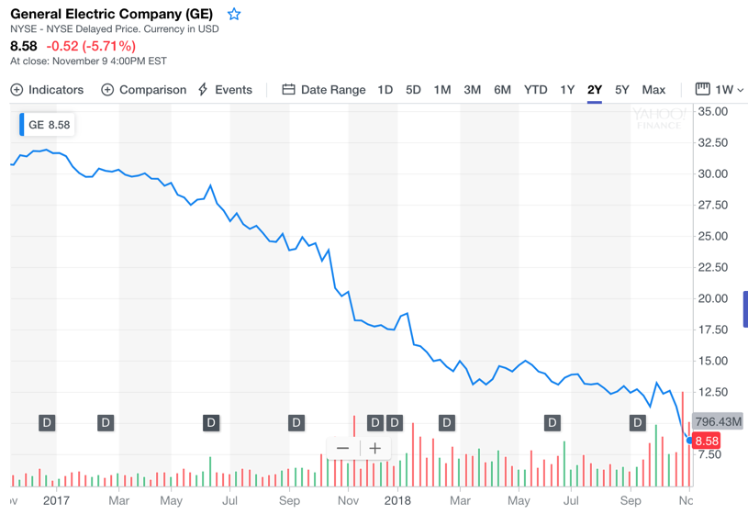
Why Important
Notes:
Barriers - being sother

Slide 11
Examples
Lead Developer leaves the project mid project
Your team deleted the server with the backups and images
Team member that is failing
Project going to be over budget
Client team not

Slide 12
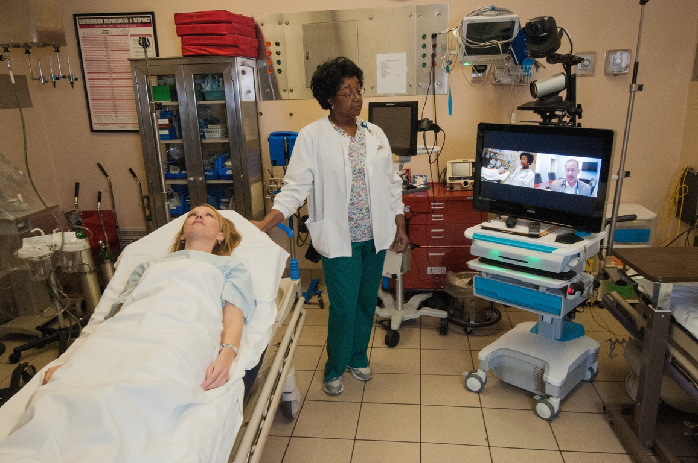
Turns out…
"20130306-OC-RBN-3919" (CC BY 2.0) by USDAgov
Notes:
Sources:
Fierce conversations
Radical candor
Onc

Slide 13
Some Assumptions

Slide 14
Assumptions
You desire a successful outcomes.
You believe in transparency.
You know enough to know that a conversation is needed.
You know what the need for difficult conversation is.

Slide 15
1. Have Them Early

Slide 16
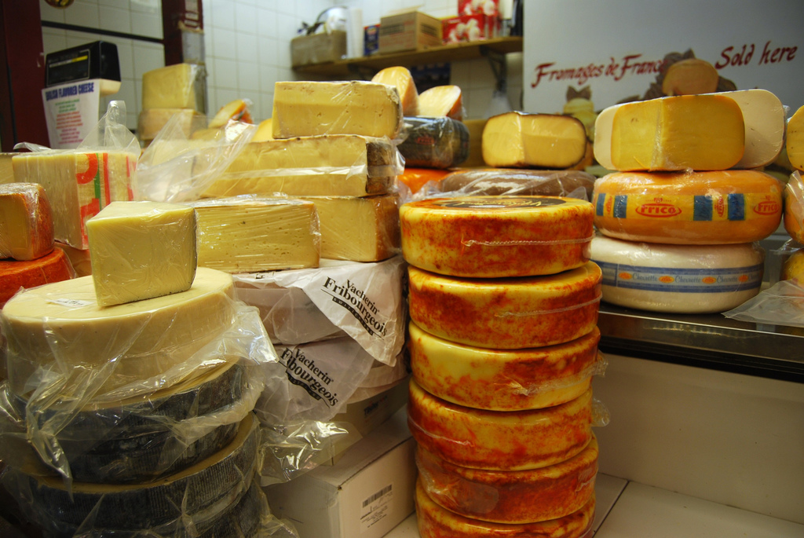
Turns out
Notes:
cheese better with time

Slide 17
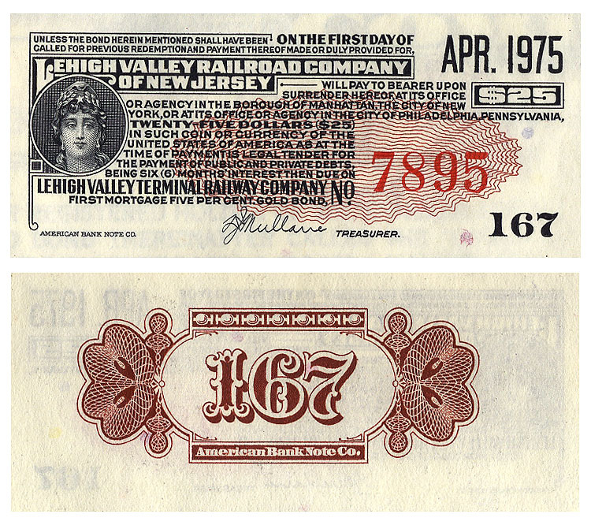
"Lehigh Valley Terminal bond back, 1891" (CC BY 2.0) by crackdog
Notes:
bonds gain value with time

Slide 18
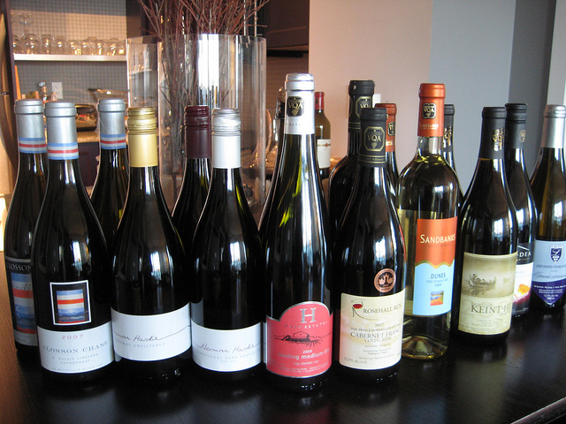
Turns out
Notes:
Wine better with time

Slide 19
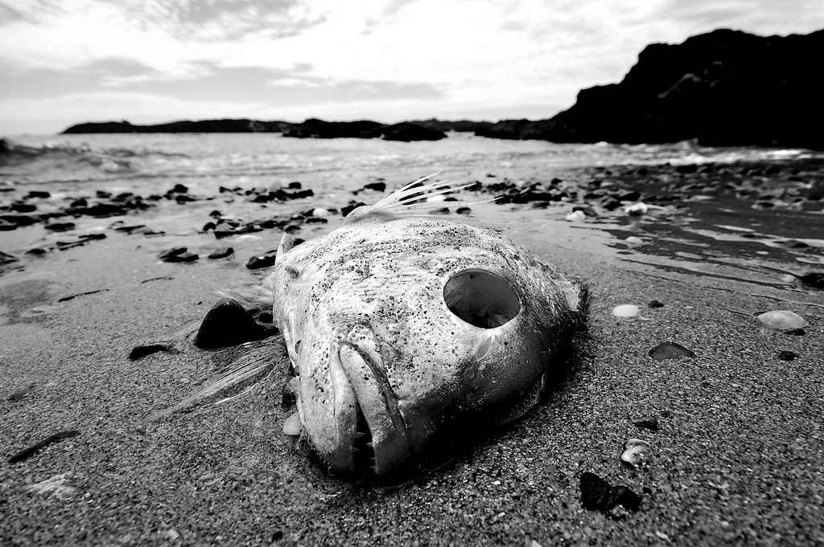
Turns out
"Dead" (CC BY-NC 2.0) by Daniel Pietzsch
Notes:
Difficult conversations are like dead fish. They don’t get better with time.
Early conversations prevent more difficult conversations.

Slide 20
2. Set the Stage

Slide 21
Abrupt
Notes:
Don’t sneak up and present the cold dead fish of truth. not fair to you or anyone else.
Doctor’s example
Your lab results are in, We would like you to come in to discuss Signal before
Email
Risk register etc

Slide 22
Preparation
Define purpose and desired outcomes. "Before any difficult conversation, you need to ask yourself a couple important questions: What is my purpose in having this conversation? What is the ideal outcome?" Before going any further, make sure you can proceed with a positive, supportive mindset.

Slide 23
Preparation
Know your assumptions. Ask yourself what you're assuming about the other person's intentions.

Slide 24
3. Connect Personally

Slide 25
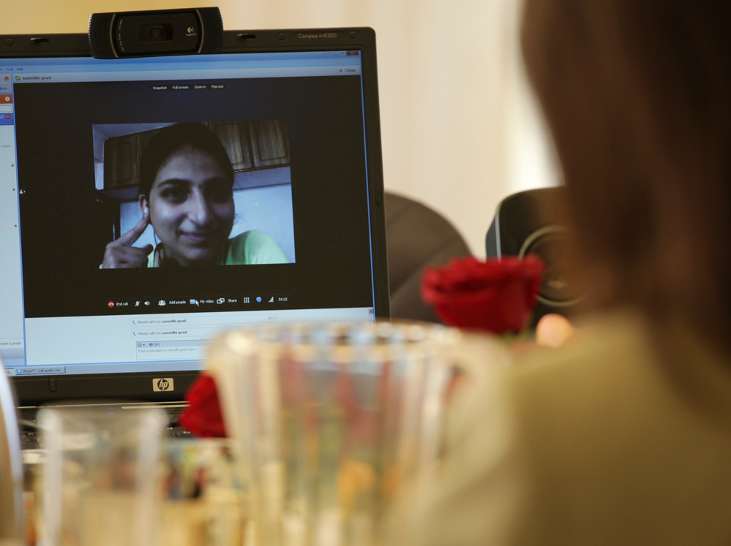
Connect
Repeat Shared goals - Project goals
In person / Call / Video Conference

Slide 26
Connect
Repeat Shared goals - Project goals
In person / Call / Video Conference
Notes:
Connect with the person (s) on the personal basis of why you are having the call.
Feedback without compassion = just an ass

Slide 27
Connect
Notes:
Connect with the person (s) on the personal basis of why you are having the call.
Feedback without compassion = just an ass

Slide 28
4. Communicate Precisely

Slide 29
Precise
Exact, sharp language of facts keeps you out of the ditches
Deliver the conversation and exit the conversation
Notes:
Example:
We have no idea why the server is down vs At 8:30 this morning our monitoring system alerted us to an outage on the production server for your site. At this time it is still down. A team is working on the issue now
Employee example:
You suck vs I have some concerns about your work on the Project. During the last week your commits have failed to deploy on the CI system. The level of effort has been 50% over your estimates.

Slide 30
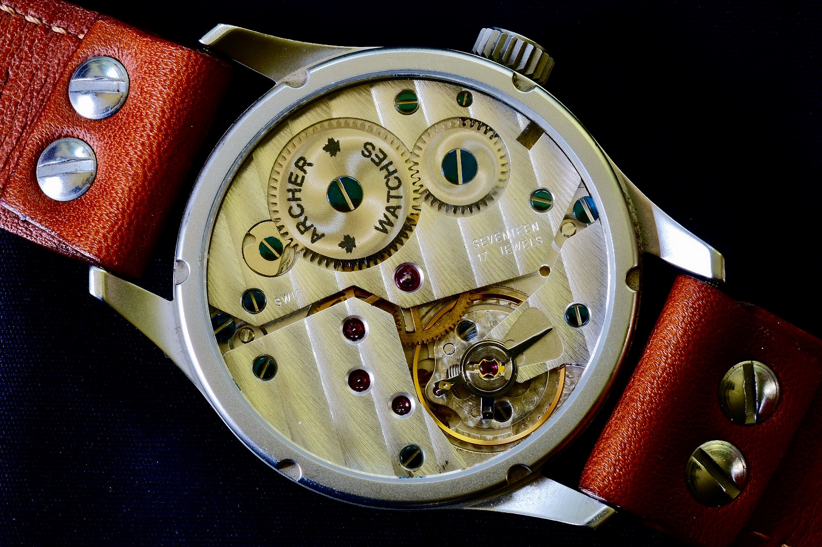
Precise
Exact, sharp language of facts keeps you out of personal ditches
"Archer Aero II" (CC BY 2.0) by peterclifford1
Notes:
Example:
We have no idea why the server is down vs At 8:30 this morning our monitoring system alerted us to an outage on the production server for your site. At this time it is still down. A team is working on the issue now
Employee example:
You suck vs I have some concerns about your work on the Project. During the last week your commits have failed to deploy on the CI system. The level of effort has been 50% over your estimates.

Slide 31
5. Problem Solve Together

Slide 32
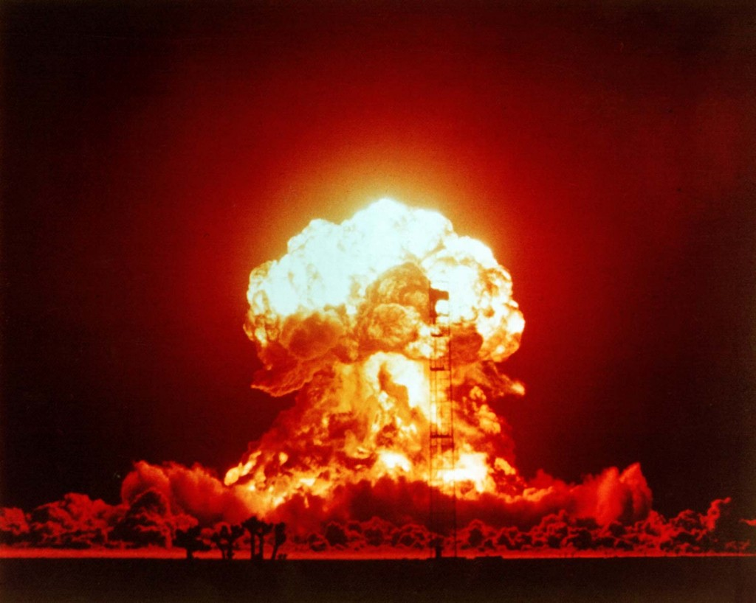
Respond
Notes:
You may be expecting an explosion

Slide 33
Respond
"Unicorn" (CC BY-SA 2.0) by scorpiorules58
Notes:
Or you may expect to have unicorns and rainbows

Slide 34
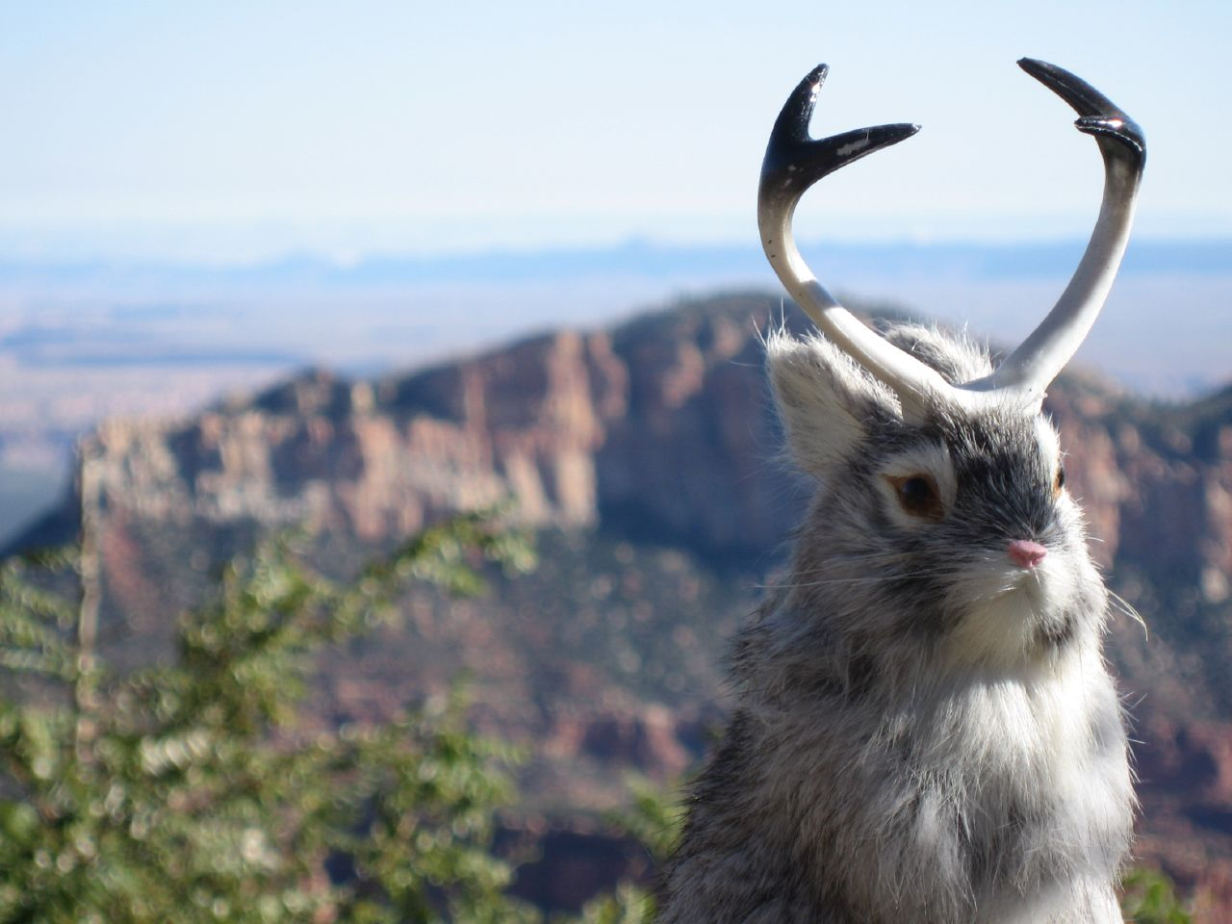
Respond
"Jackalope, Grand Canyon North Rim, Oct 0" (CC BY 2.0) by Free-ers
Notes:
Most of the time: Combination. If you have a

Slide 35
6. Follow with Action

Slide 36
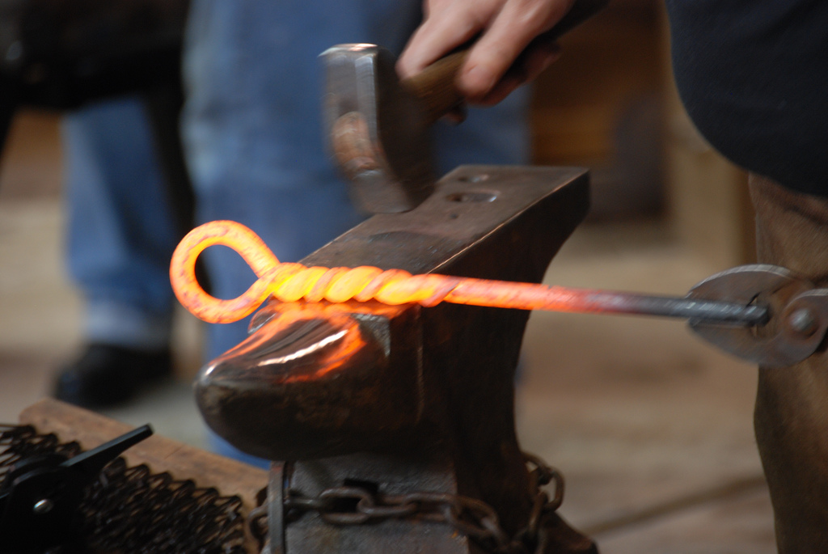
Actions
"DSC_0049" (CC BY-SA 2.0) by Kenzs photos
Notes:
All conversations involve some kind of follow up action

Slide 37
Action Guide
Specific
Time bound
Document in writing

Slide 38
Mitigating
Call out risks
Talk/Document what could go wrong
Example discussions.
Notes:
Running Risks lists
Written communications - email
We have discovered a serious issue and need to talk

Slide 39
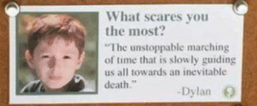
Inevitable
Notes:
The only thing worse than having a difficult conversation - Not having one.
The best time is as soon as you thought you needed it, The second best time is NOW

Slide 40
Recap Conversation
Have them early.
Set the Stage.
Connect Personally.
Communicate Precisely
Problem solve together.
Follow with Action

Slide 41
Questions

Slide 42
Reading List

Slide 43
Citations
Bailea, Walter F., et al. “Walter F. Baile.” The Oncologist, AlphaMed Press, 1 Aug. 2000, theoncologist.alphamedpress.org/content/5/4/302.long.

Slide 44
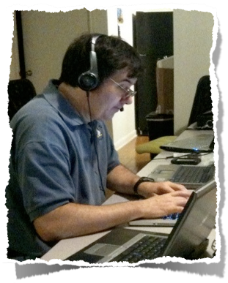
THANK YOU!
Johnnie Fox
Johnnie@johnniefox.com
twitter: johnniefox

Slide 45
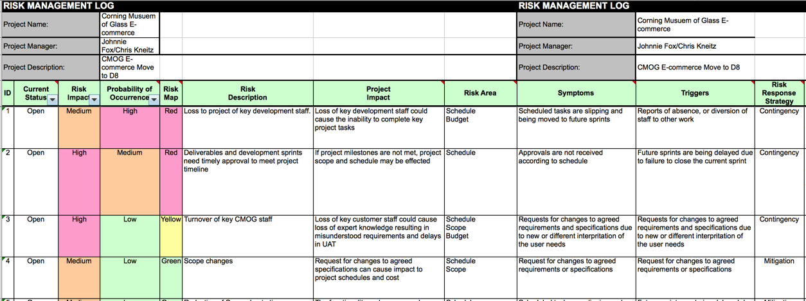
Risk Register

